Slide 1
Project Deadline Reminder System
By : Jatin Ponam 2420030032
Tejaswi Priyank 2420030276
Pranay Sangam 2420090115

Slide 2
Problem Statement & Objectives
Problem Statement
Students have many project tasks and deadlines.
It is difficult to remember every deadline.
Missing deadlines can delay project completion.
A simple system is needed to track tasks and deadlines.

Slide 3
Objectives
Add and manage projects.
Add tasks with deadlines.
Track task status.
Remind users about upcoming deadlines.
Help complete projects on time.

Slide 4
Project Design
User Module
  User registration and login.
Project Module
  Create and manage projects.
Task Module
  Add tasks and assign deadlines.
Reminder Module
  Check upcoming deadlines and send reminders.
Dashboard
  View pending, completed and upcoming tasks.

Slide 5
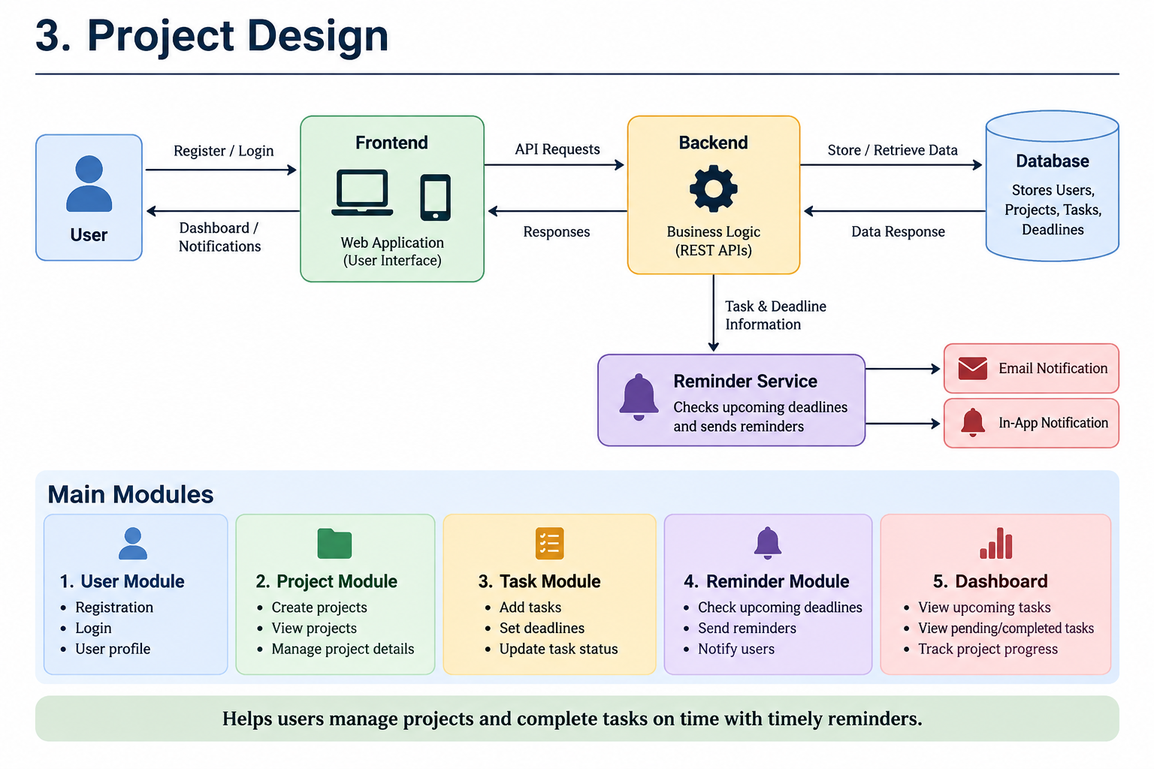

Slide 6
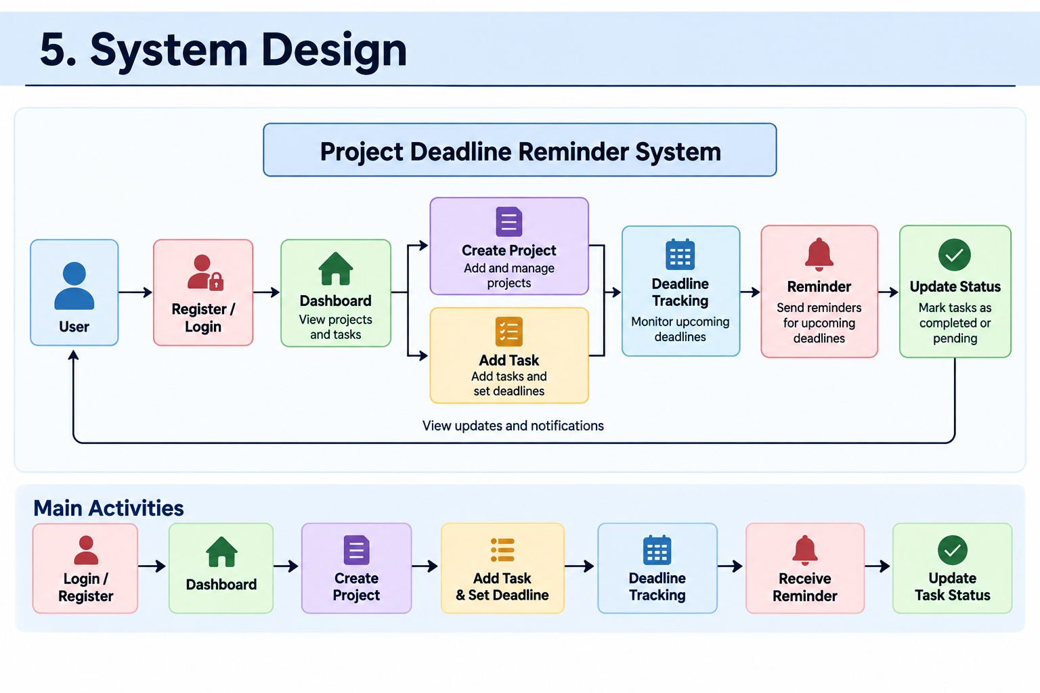

Slide 7
Methodology Adopted
Requirement Analysis – Identify project requirements.
Planning – Plan tasks and project activities.
Design – Design the system and database.
Development – Develop the project features.
Testing – Test the system and fix errors.
Review & Improvement – Review the results and make improvements.

Slide 8
Technical Implementation
Technologies Used
Frontend: HTML, CSS, JavaScript
Backend: Java / Spring Boot
Database: PostgreSQL
API: REST API
Development Tool: VS Code
Main Features
User Login
Project Management
Task Management
Deadline Tracking
Reminder System
Task Status Update

Slide 9
Result & Future Scope
Result
Projects and tasks are managed easily.
Deadlines are tracked.
Upcoming deadlines are identified.
Reminders help users complete tasks on time.
Future Scope
Email notifications
Mobile application
Calendar integration
Team collaboration

Slide 10
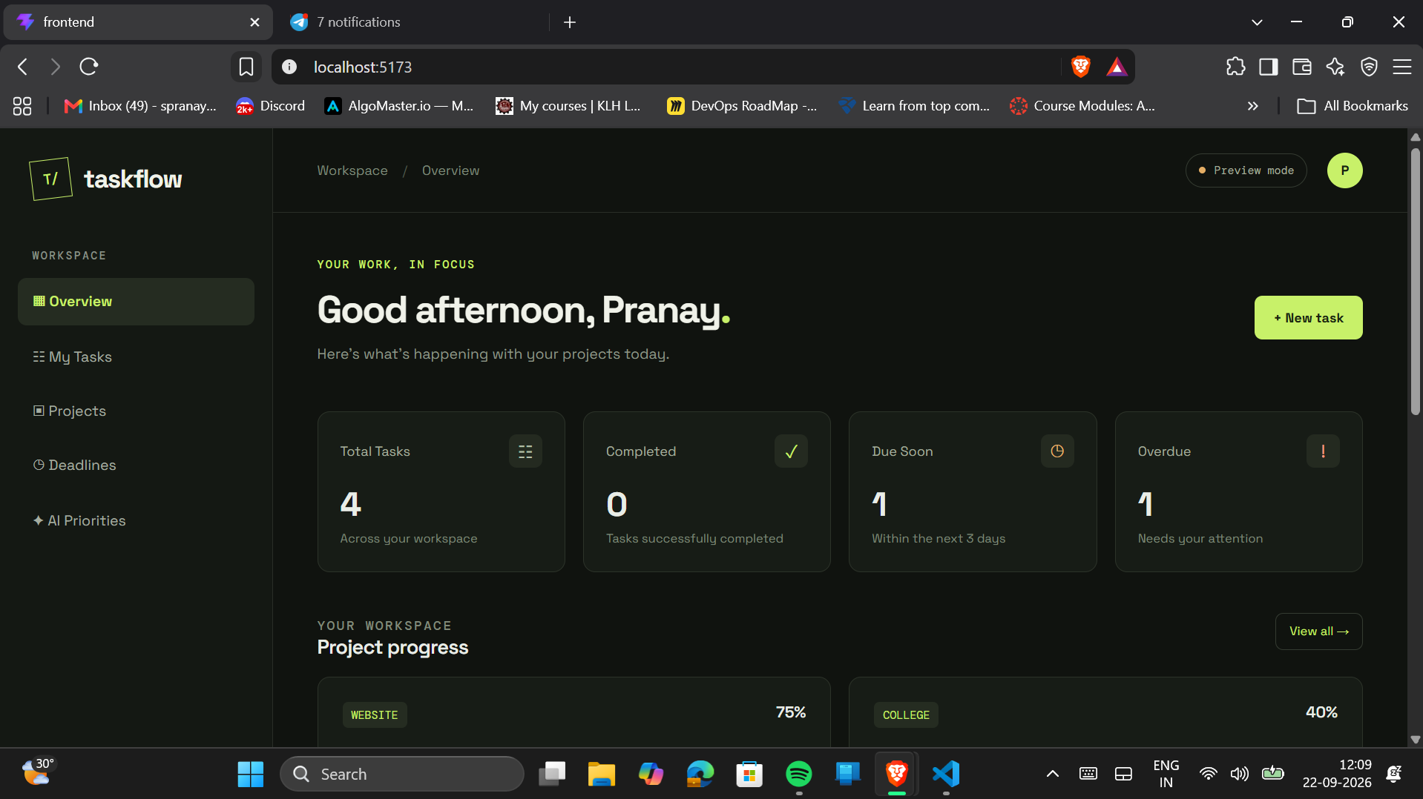
Execution

Slide 11
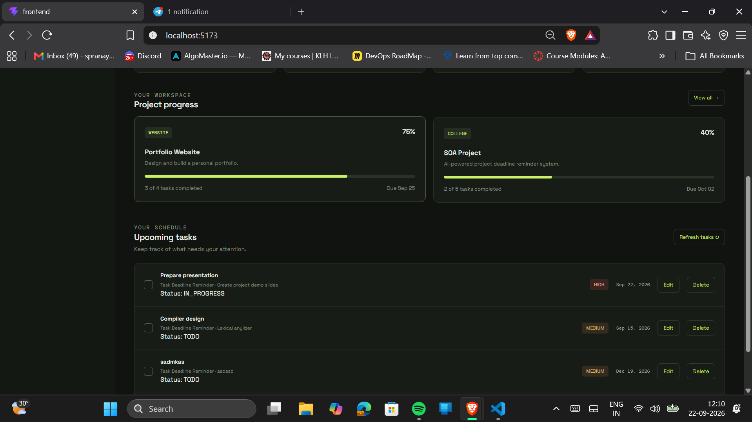

Slide 12
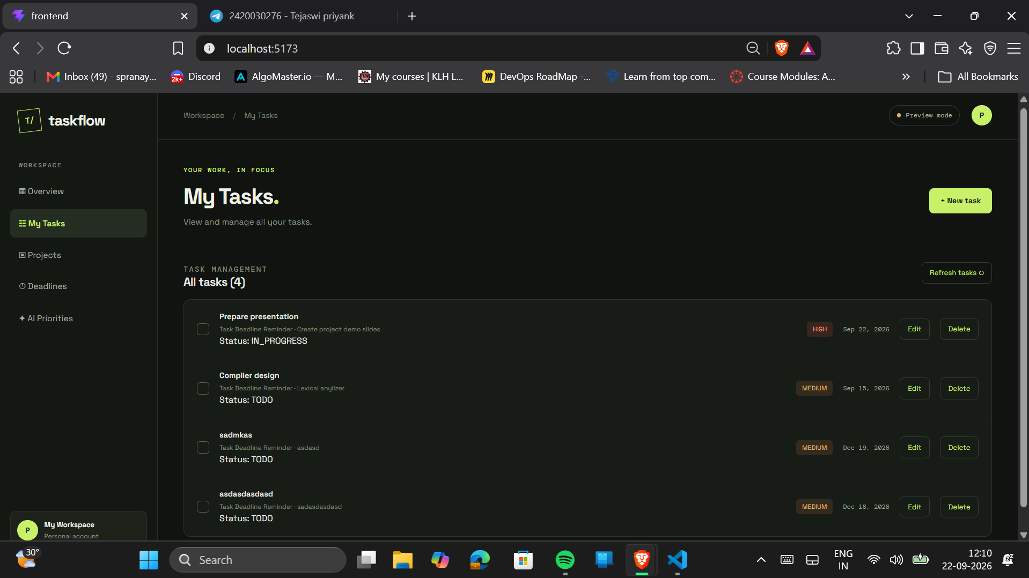

Slide 13
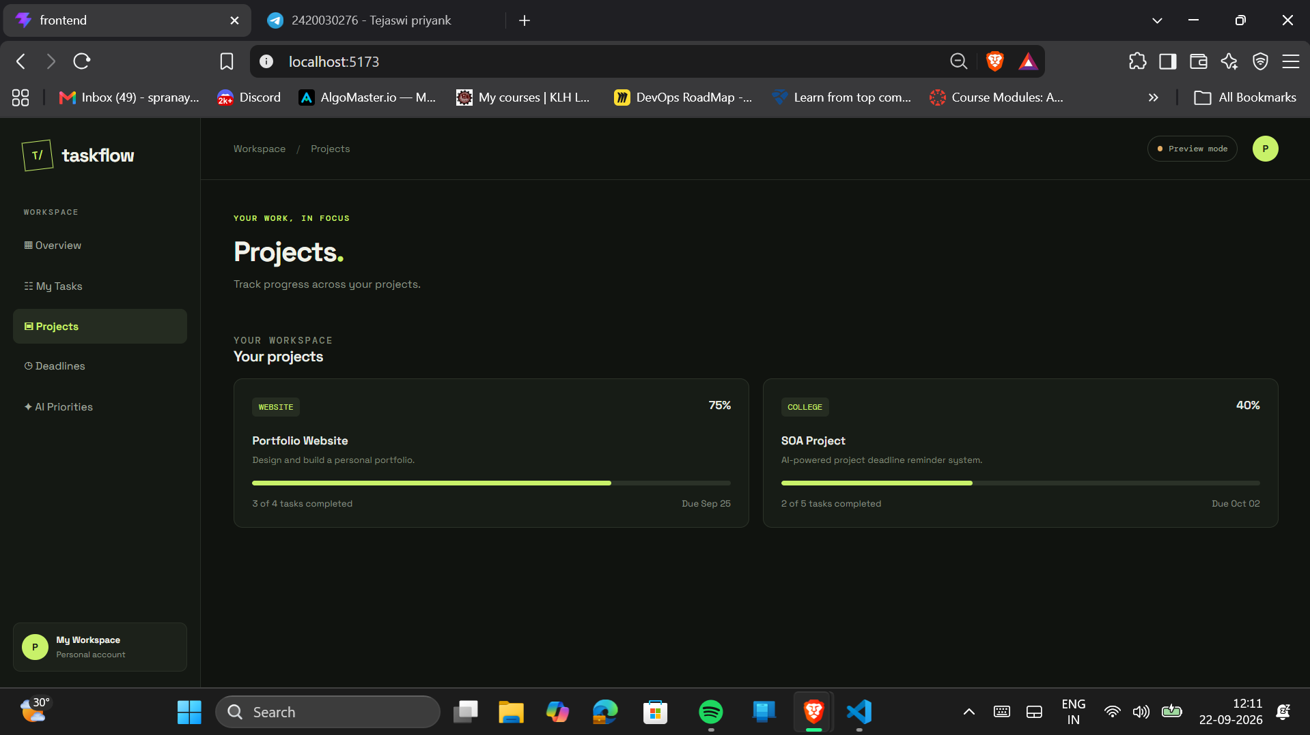

Slide 14
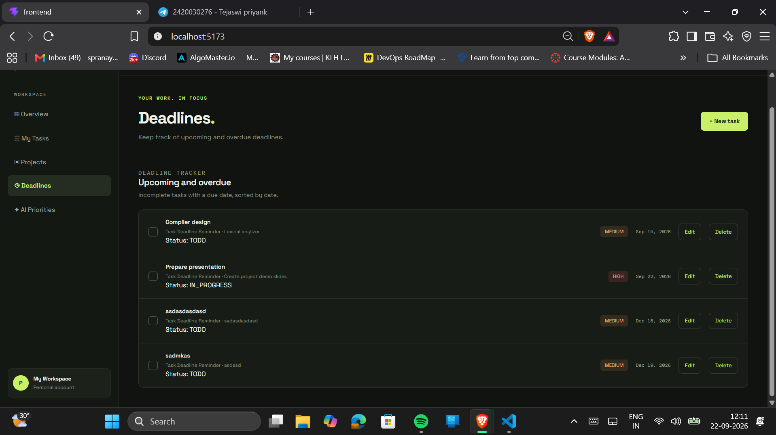

Slide 15
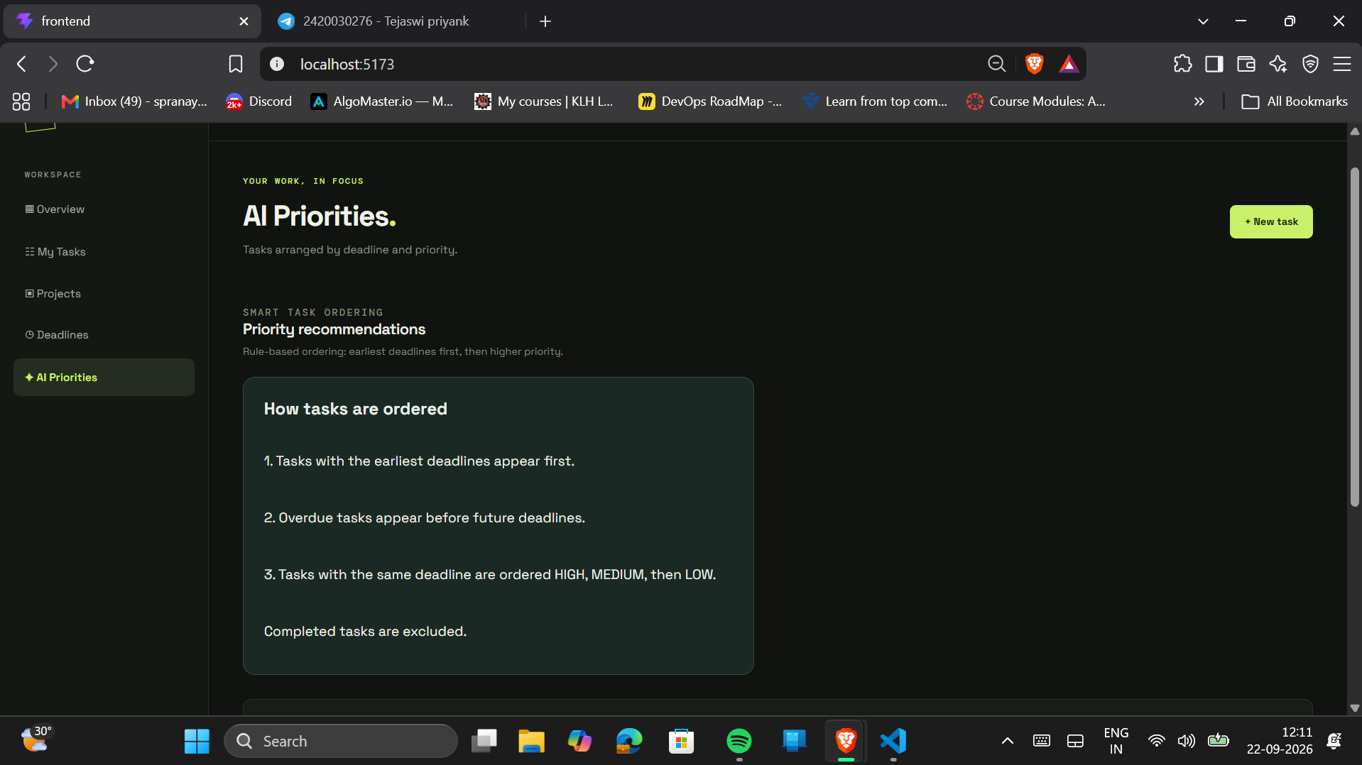

Slide 16
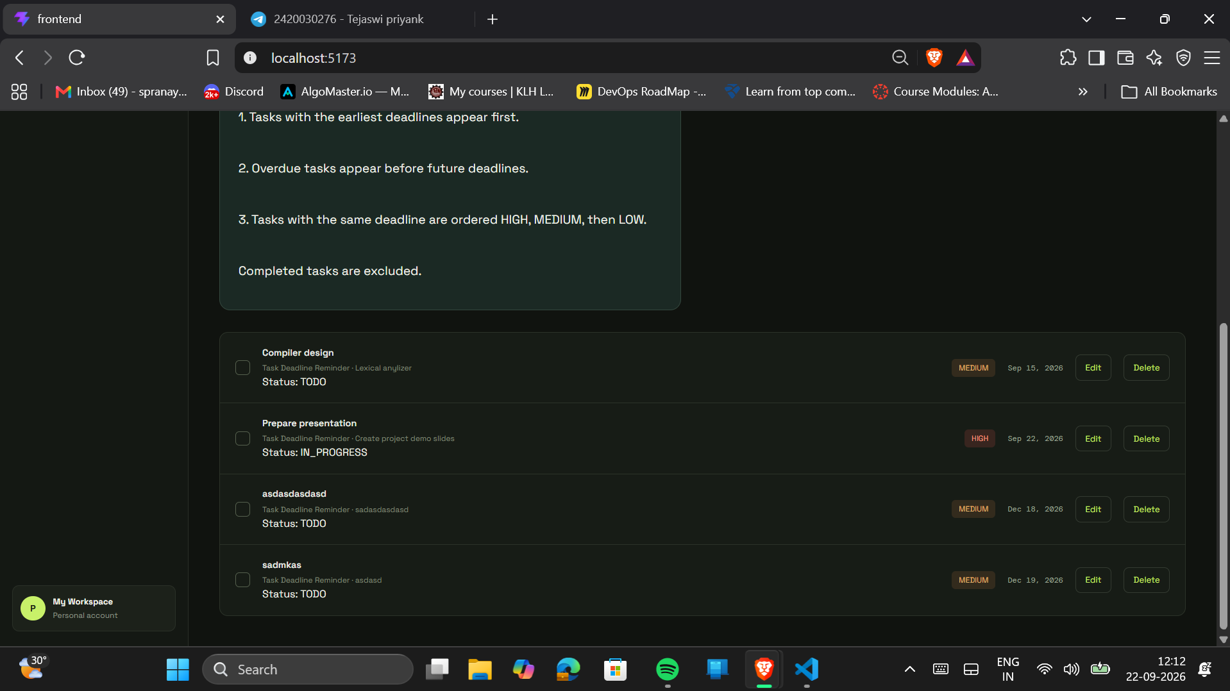

Slide 17
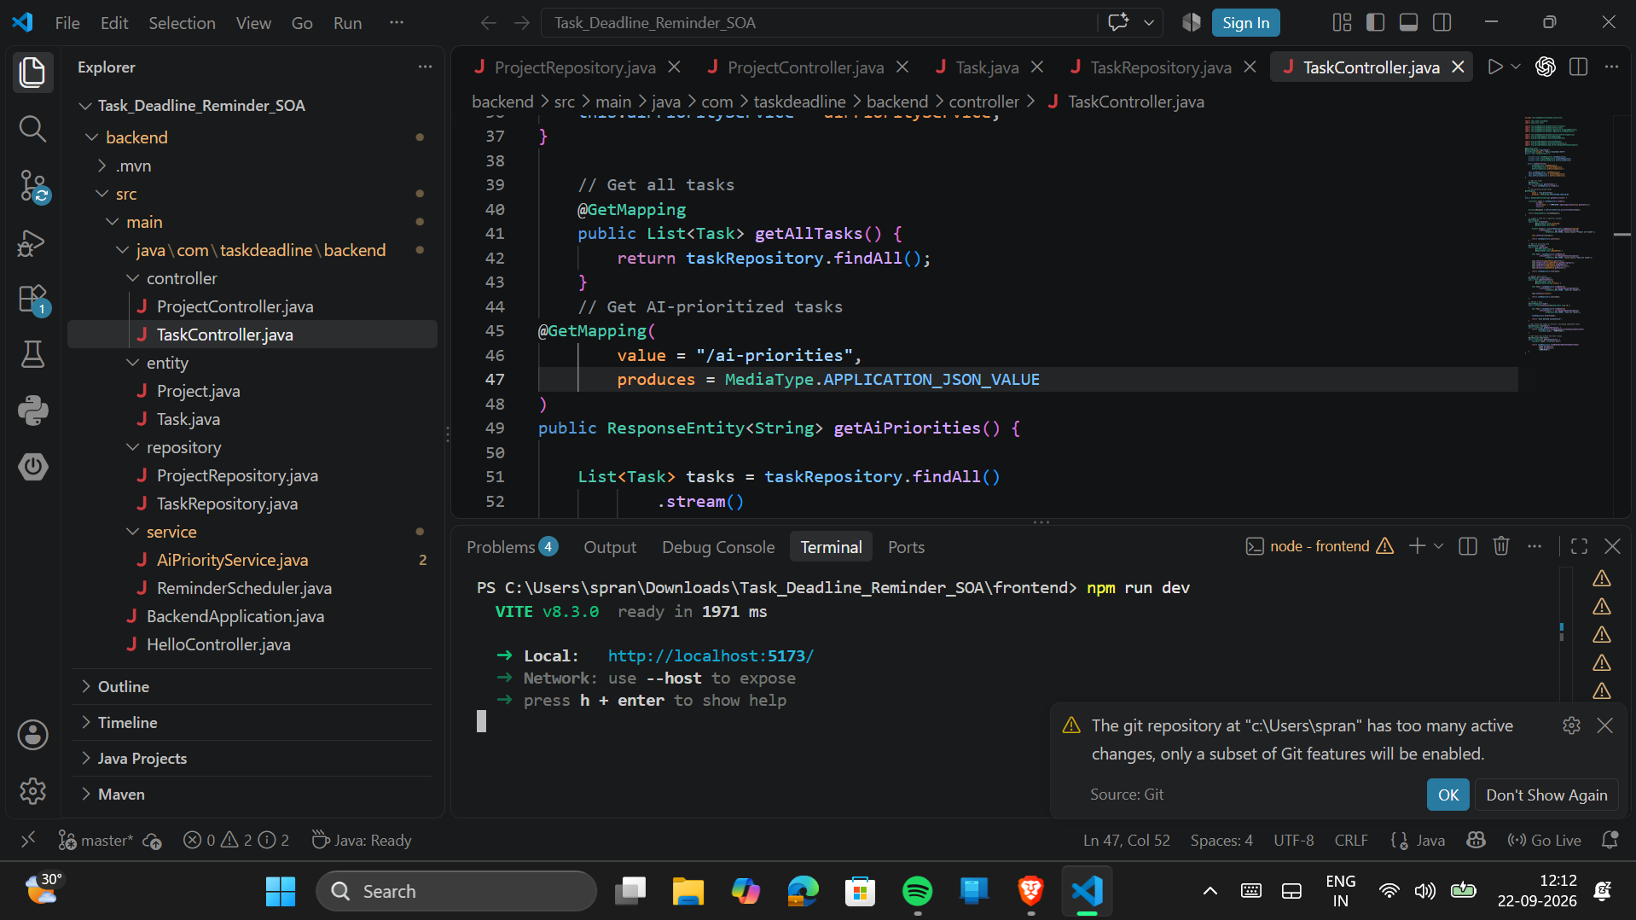

Slide 18
